Slide 1
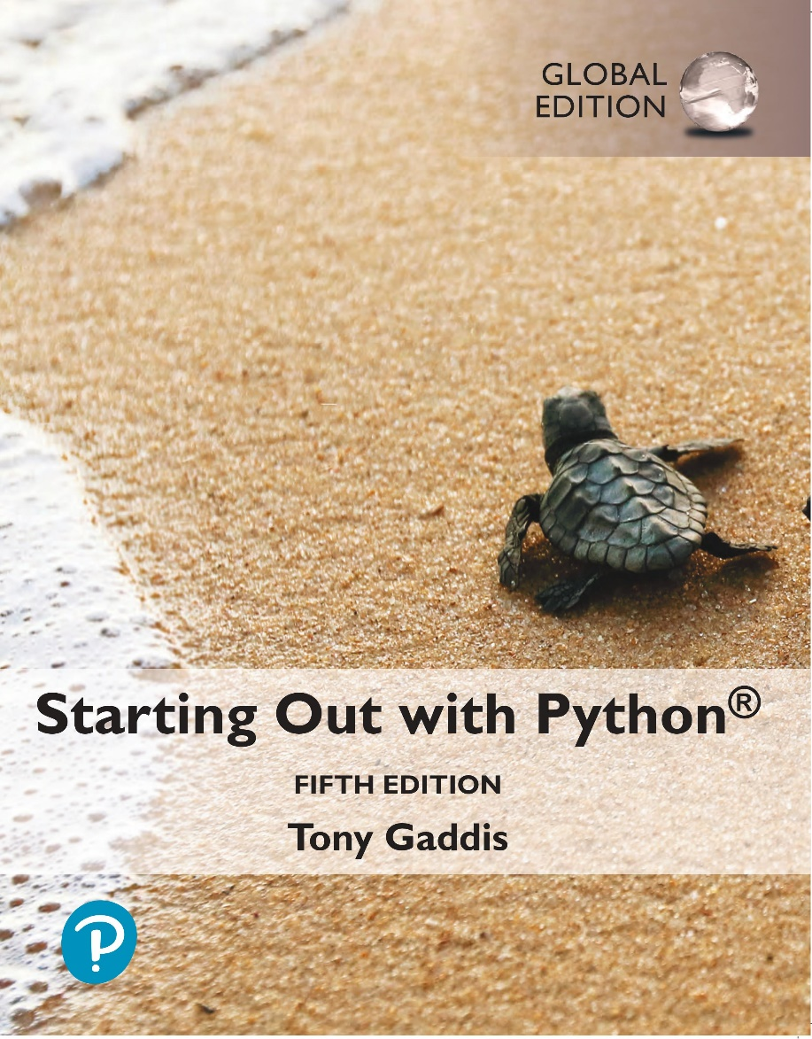
Starting out with Python
Fifth Edition, Global Edition
Chapter 1
Introduction to Computers and Programming
Copyright © 2022 Pearson Education, Ltd. All Rights Reserved.

Slide 2
Topics
Using Python

Slide 3
Using Python
Python must be installed and configured prior to use
One of the items installed is the Python interpreter
Python interpreter can be used in two modes:
Interactive mode: enter statements on keyboard
Script mode: save statements in Python script

Slide 4
Interactive Mode
When you start Python in interactive mode, you will see a prompt
Indicates the interpreter is waiting for a Python statement to be typed
Prompt reappears after previous statement is executed
Error message displayed If you incorrectly type a statement
Good way to learn new parts of Python

Slide 5
Writing Python Programs and Running Them in Script Mode
Statements entered in interactive mode are not saved as a program
To have a program use script mode
Save a set of Python statements in a file
The filename should have the .py extension
To run the file, or script, type
python filename
at the operating system command line

Slide 6
The IDLE Programming Environment
IDLE (Integrated Development Program): single program that provides tools to write, execute and test a program
Automatically installed when Python language is installed
Runs in interactive mode
Has built-in text editor with features designed to help write Python programs

Slide 7
Summary
This chapter covered:
Installing Python and the Python interpreter modes

